Slide 1


Computer Science Club
2022-2023
Welcome! Thank you so much for stopping by!

Slide 2



What will we do in Compsci club?
Programming
Collaborate
Discover
As the name implies, we are going to do a lot of hands-on programming activities in CompSci Club! Exercises are the best way to cement your knowledge!
Computer Science is not a solo journey! You learn and have a lot more fun when you work together. As Yoda said, “Pass on what you have learned.”
There is always something new to find out in CompSci! From guest speakers, fun hackathons, and even working with other clubs we have so much planned this year!

Slide 3





Who can Join CompSci Club? (Anyone!)
Track ONe
Track Two
Taught by Arnav
Taught by Fillip
Perfect for beginners or people who need a refresher on the fundamentals!
Ideal for those who attended CompSci last year or have some coding fundamentals (not just in Python!)
A comprehensive and detailed curriculum that starts with the basics and works up
A review of the basics before delving into deeper and more powerful topics
Interactive projects and exercises to put your knowledge into practice
Interactive projects and exercises to put your knowledge into practice!

Slide 4


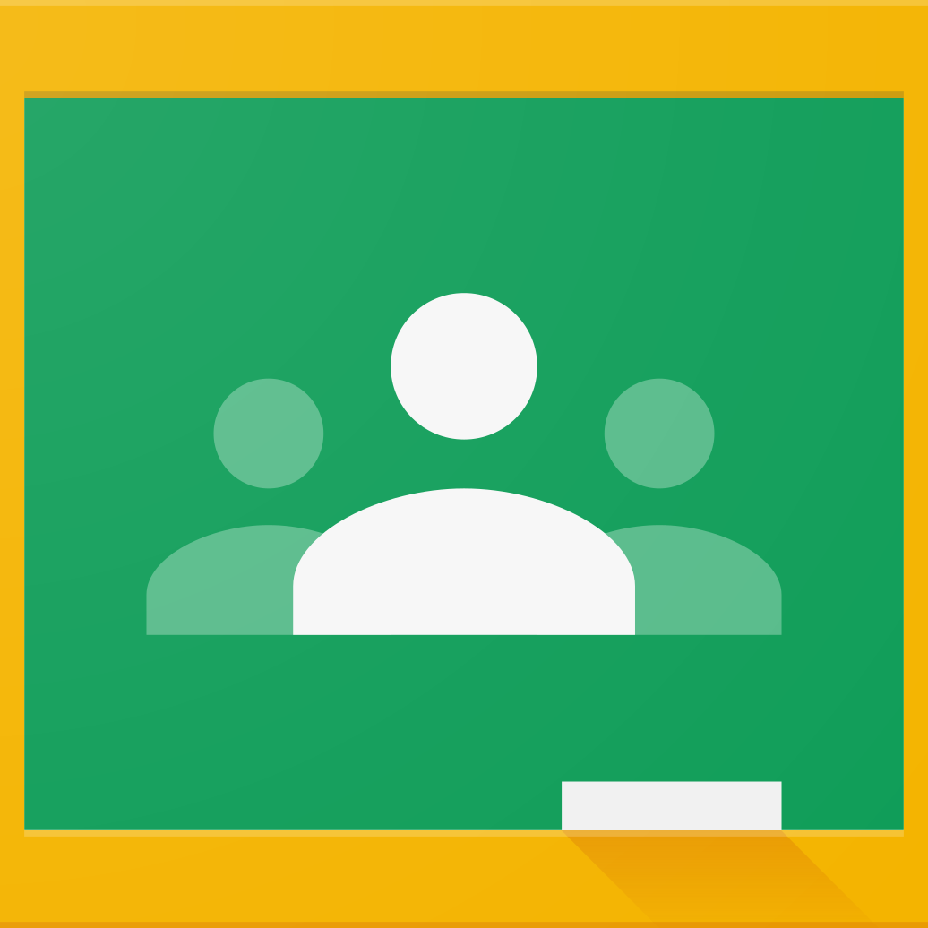
What if I miss a meeting?
We realize that having an after school club can sometimes lead to you not being able to make it
We have an organized Google Drive folder and GitHub so that you can access everything that Computer Science does
New this year! We decided to have a Google Classroom to house all of our materials and announcements. Invite code coming soon!

Slide 5
Question & Answer
Question: Will we be just doing Python during the year?
Answer: That is entirely up to you! We start with Python because of it’s easy readable syntax and it’s wide range of capabilities. However, during the club fair we saw a lot of you had experience in other languages. You are welcome to incorporate those into our curriculum for this year!
Question: In Computer Science Club, will we be doing [insert cool thing]?
Answer: Once again, it’s your choice! Some of you are incredibly interested in game design while others are machine learning finantics. If you have something you want to learn or build, tell us!
Question: What does a typical day of CompSci Club look like?
Answer: Good question! We start each meeting with a warm-up, which this year we will try to limit to 5-10 minutes. Then, we will either have a presentation about a new concept, a project introduction or work time. However, this is tentative and changes a lot!

Slide 6
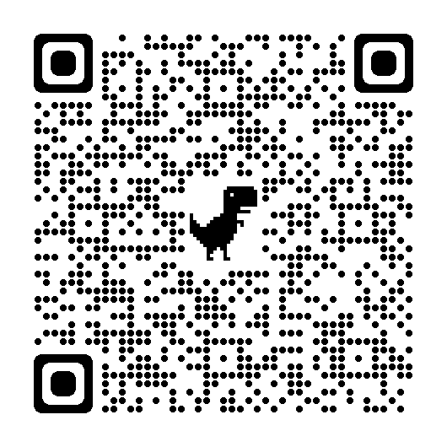
One Last thing!
Please fill out the Google Form with the QR Code to the right to let us know what you are looking to get out of CompSci this year. It can be anonymized, so feel free to be honest!
https://forms.gle/knrt4GPz65KAarB36

Slide 7
Ask us about anything!
Questions?
Thank you so much for attending the first CS meeting of this year! We will see you all next week for our first meeting on Tuesday, September 6 from 3 to 3:40

